Slide 1
Soft Clustering

Slide 2
Soft Clustering
So far, clustering was done using hard assignments (1 point -> 1 cluster)
Sometimes this doesn’t accurately represent the data: it seems reasonable to have overlapping clusters.
In this case, we can use soft assignment to assign points to every cluster with a certain probability.

Slide 3
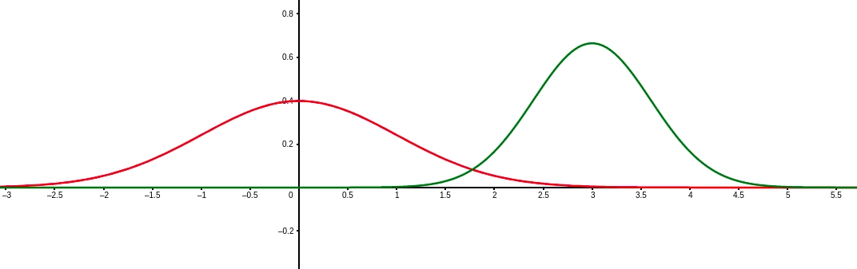
Soft Clustering - Example
Generate data using N(𝝻₁, 𝞂₁) and N(𝝻₂, 𝞂₂)
Or: we are given the weights of animals. Unknown to us these are weights from two different species.
Can we determine the species (group / assignment) from the height?

Slide 4
Soft Clustering - Example
Generate data using N(𝝻₁, 𝞂₁) and N(𝝻₂, 𝞂₂)

Slide 5
Soft Clustering - Example
Generate data using N(𝝻₁, 𝞂₁) and N(𝝻₂, 𝞂₂)
Any of these points could technically have been generated from either curve.

Slide 6
Soft Clustering - Example
Generate data using N(𝝻₁, 𝞂₁) and N(𝝻₂, 𝞂₂)
For each point we can compute the probability of it being generated from either curve

Slide 7
Soft Clustering - Example
Generate data using N(𝝻₁, 𝞂₁) and N(𝝻₂, 𝞂₂)
We can create soft assignments based on these probabilities.

Slide 8
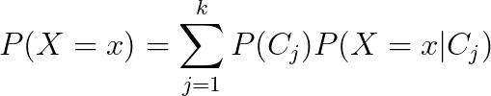
Mixture Model
X comes from a mixture model with k mixture components if the probability distribution of X is:
Mixture proportion
Represents the probability of belonging to C_{j}
Probability of seeing x when sampling from C_{j}

Slide 9
Example
What is the probability distribution here?

Slide 10
Example

Slide 11
Example

Slide 12
Gaussian Mixture Model
A Gaussian Mixture Model (GMM) is a mixture model where

Slide 13
GMM Clustering
Goal: Find the GMM that maximizes the probability of seeing the data we have.
The probability of seeing the data we saw is (assuming each data point was sampled independently) the product of the probabilities of observing each data point.
Finding the GMM means finding the parameters that uniquely characterize it. What are these parameters?
P(C_{i}) & 𝝻_{i} & 𝞂_{i} for all k components.
Lets call Θ = {𝝻₁, …, 𝝻_{k} , 𝞂₁, …, 𝞂_{k}, P(C₁), ..., P(C_{k})}

Slide 14
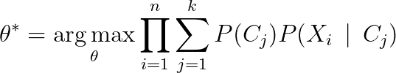
GMM Clustering
Goal:
Where Θ = {𝝻₁, …, 𝝻_{k} , 𝞂₁, …, 𝞂_{k}, P(C₁), ..., P(C_{k})}
Joint probability distribution of our data
Assuming our data are independent

Slide 15
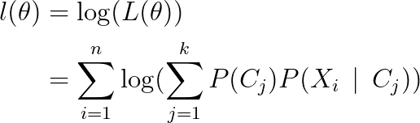
GMM Clustering
How do we find the critical points of this function?
Notice: taking the log-transform does not change the critical points
Define:

Slide 16


GMM Clustering
For 𝝻 = [𝝻₁, …, 𝝻_{k}]^{T} and 𝝨 = [𝝨₁, …, 𝝨_{k}]^{T}
We can solve

Slide 17



GMM Clustering
To get

Slide 18
GMM Clustering
Do we have everything we need to solve this?
Still need P(C_{j} | X_{i}) (i.e. the probability that X_{i} was drawn from C_{j})

Slide 19
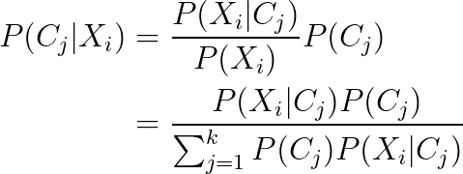
GMM Clustering
Looks like a loop! Seems we need P(C_{j}) to get P(C_{j} | X_{i}) and P(C_{j} | X_{i}) to get P(C_{j})

Slide 20
Expectation Maximization Algorithm
Start with random θ
Compute P(C_{j} | X_{I}) for all X_{i} by using θ
Compute / Update θ from P(C_{j} | X_{I})
Repeat 2 & 3 until convergence

Slide 21
Demo

